Slide 1
Examination Timetable Generation
PIP2001 Capstone Project
Final Review
Batch Number: CSD-G06
Roll Number 20211CSD0185 20201CSD0078 20221LSD0186 20221LSD0033 | Student Name Sarvesh Patil Parashuram Harish P K Naveen Kumar R S
Under the Supervision of,
Dr./Mr./Ms./Prof.
Professor / Associate Professor / Assistant Professor
School of Computer Science and Engineering
Presidency University
Name of the Program: CSE- Data Science
Name of the HoD: Dr. Saira Banu Atham
Name of the Program Project Coordinator: Mrs. Shaik Salma Begum
Name of the School Project Coordinators: Dr. Sampath A K / Dr. Abdul Khadar A / Mr. Md Ziaur Rahman

Slide 2
Introduction
This project aims to create an automated system that generates efficient, conflict-free examination schedules, ensuring fair distribution of students, faculty invigilators, and exam halls.
A well-structured timetable ensures smooth conduct of exams, prevents clashes, and optimizes resource utilization.
From traditional paper-based methods to AI-powered automated systems, timetable generation has evolved significantly to handle complex academic structures.

Slide 3
Literature Review
Carter, M. W., et al. (1996) - Algorithmic strategies for examination timetabling.
Burke, E. K., & Newall, J. P. (1999) - Multi-stage evolutionary algorithms for timetable problems.
Cordeau, J. F., & Laporte, G. (2001) - Tabu search for timetabling.
Kassa, S., & Naji, Y. (2011) - Integer programming for exam timetabling.
Pisinger, D., & Ropke, S. (2010) - Constraint programming for timetabling.

Slide 4
Existing method Drawback
Existing methods such as manual scheduling and basic heuristics face issues like scalability, slow convergence, limited flexibility, and difficulty in real-time adaptation.

Slide 5
Proposed Method
Combines constraint-based modeling with genetic algorithms and simulated annealing to generate optimized examination schedules, ensuring non-consecutive seating and fair faculty distribution.

Slide 6
Objectives
Develop an automated timetable generation system.
Ensure conflict-free scheduling.
Implement fair student distribution.
Optimize room allocation.
Efficient faculty assignment.
Adapt to dynamic inputs.
Provide a clear and comprehensive output.

Slide 7
Methodology/Modules
The system includes modules for:
Data preprocessing
Constraint checking
Optimization
Room allocation
Faculty assignment
Subject scheduling
Notification handling

Slide 8
Architecture
UI for input, backend engine for processing, database for managing inputs and results, and output layer for displaying schedules.

Slide 9
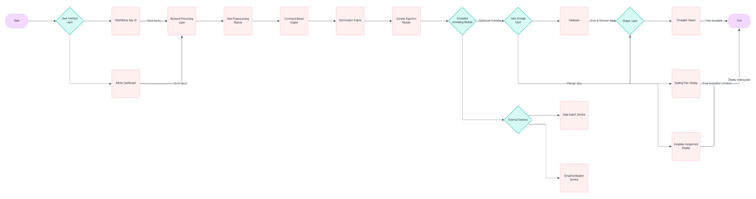
Architecture

Slide 10
Hardware/software components
Hardware:
Server with Intel Core i5, 16 GB RAM, 512 GB SSD.
Software:
.NET Core, SQL Server, ASP.NET, Genetic Algorithm Libraries, Simulated Annealing Libraries.

Slide 11
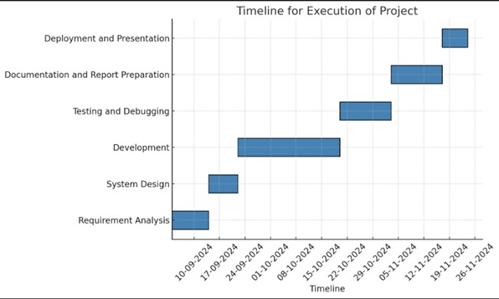
Timeline of Project

Slide 12
Expected Outcomes
Automated, conflict-free exam timetable generation.
Efficient room utilization and fair student distribution.
Scalable and adaptable system for handling changes.

Slide 13
Conclusion
The project aims to enhance examination management efficiency by implementing a fair, automated, and optimized scheduling system.Automated timetable generation improves efficiency, reduces errors, and ensures a fair and conflict-free exam schedule.

Slide 14
Github Link
The Github link provided should have public access permission.
GithubLink :
https://github.com/Sarveshveeru1/Examination-Time-table-Generation

Slide 15
References
A Multi-Agent System for Course Timetable Generation" - By A. Capatina, S. Oprea, and G. Oprea, published in TEM Journal.
A Study and Analysis of Timetable Generation using a Genetic Algorithm" - By N. S. Chavan and K. K. Patil, published in IEEE Xplore.
Automatic Timetable Generation Using Genetic Algorithm" - By S. Sharma and R. Singh, published in CORE Research Papers.
Deep Reinforcement Learning based Dynamic Optimization of Bus Timetable" - By X. Wei, J. Yin, and J. Xu, published in arXiv.org.
Specializing Narrowing for Timetable Generation: A Case Study" - By M. Hanus, published in Springer Link.
Automatic Timetable Generator using Genetic Algorithm" - By D. Patil and S. Jagdale, published in IJREAM Journal.
Automated Timetable Optimization: A Machine Learning-Based Approach" - By R. K. Gupta, published in IJCRT Journal.
Energy-optimal Timetable Design for Sustainable Metro Railway Networks" - By Q. Zhang, Y. Zheng, and Z. Liu, published in arXiv.org.
Variable Neighborhood Search Based Algorithm for University Course Timetabling Problem" - By C. Burdzik, published in arXiv.org.
Automatic generation of timetable with the ATMO tool" - By T. Paron, published in Trenolab Technical Report.

Slide 16

Project work mapping with SDG

Slide 17
Thank You

